Slide 1

6th Grade Math
Unit 2, Lesson 5 Multiplying Multi-Digit Numbers with Decimals to the Thousandths Volume 1, pg. 67

Slide 2


Benchmark
MA.6.NSO.2.1
Multiply and divide positive multi-digit numbers with decimals to the thousandths, including using a standard algorithm with procedural fluency.
volume 1, pg. 67

Slide 3
Integrated Mathematical Thinking and Reasoning Standards
MA.K12.MTR.2.1 Demonstrate understanding by representing problems in multiple ways.
MA.K12.MTR.3.1 Complete tasks with mathematical fluency.
volume 1, pg. 67

Slide 4

Learning Target
I can fluently multiply multi-digit numbers with decimals to the thousandths.
volume 1, pg. 67

Slide 5

Warm-Up
volume 1, pg. 68

Slide 6
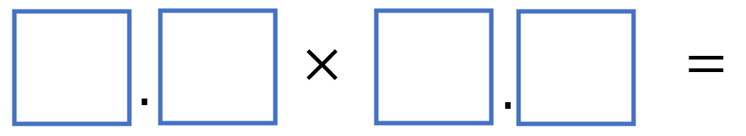
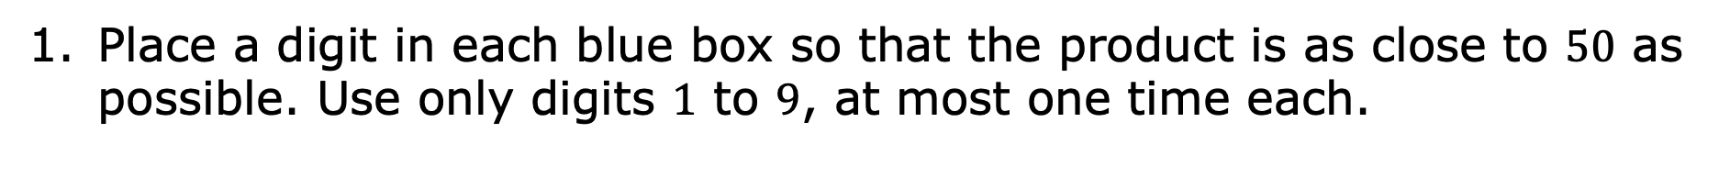
2.5.1 Warm-Up: Decimal Products
Place a digit in each blue box so that the product is as close to $50$ as possible. Use only digits $1$ to $9$, at most one time each.
volume 1, pg. 68

Slide 7

Refresher
volume 1, pg. 68

Slide 8

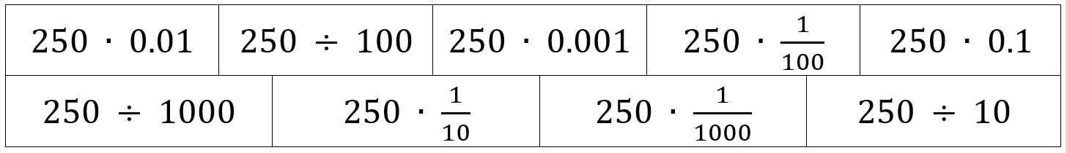
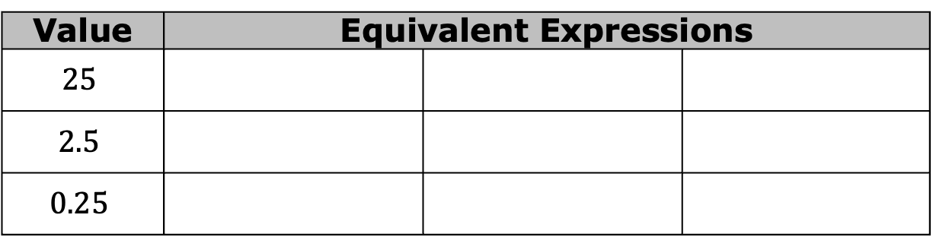
2.5.2 Refresher: Reasoning with Powers of Ten
Several expressions are shown.
Work with your partner to complete the table by writing the expressions that match each value indicated.
Value | Equivalent Expressions
$$25$$
$$2.5$$
$$0.25$$
volume 1, pg. 68

Slide 9
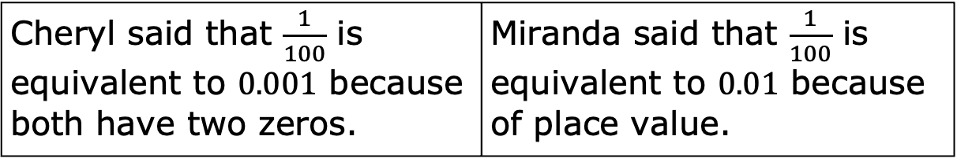
When working together through the problem, Cheryl and Miranda had a disagreement.
Which student do you agree with?
Explain why you agree.
Cheryl said that $\frac{1}{100}$ is equivalent to $0.001$ because both have two zeros. | Miranda said that $\frac{1}{100}$ is equivalent to $0.01$ because of place value.
volume 1, pg. 68

Slide 10
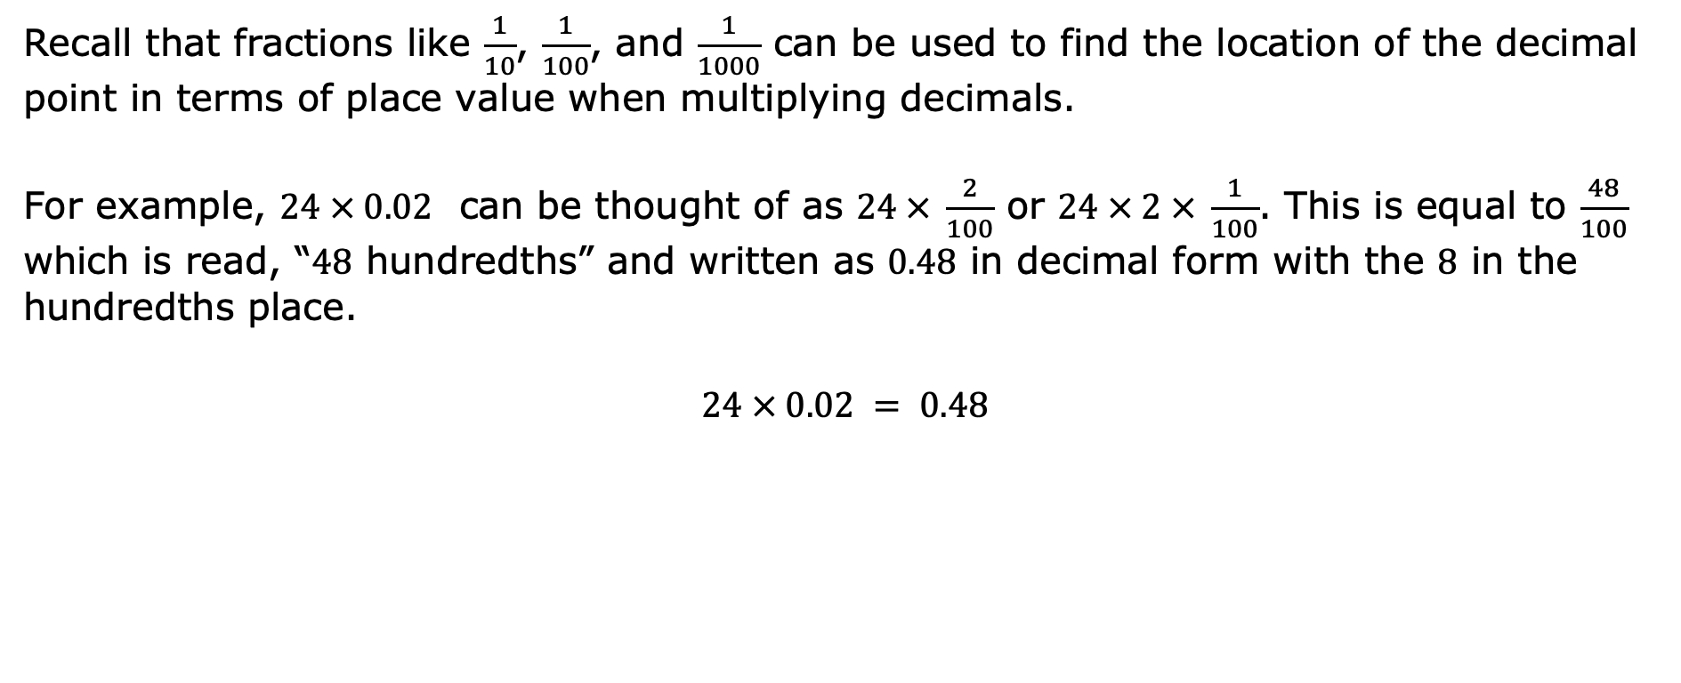
Recall that fractions like $\frac{1}{10}$, $\frac{1}{100}$, and $\frac{1}{1000}$ can be used to find the location of the decimal point in terms of place value when multiplying decimals.
For example, $24 × 0.02$ can be thought of as $24 × \frac{2}{100}$ or $24 × 2 × \frac{1}{100}$. This is equal to $\frac{48}{100}$ which is read, “$48$ hundredths” and written as $0.48$ in decimal form with the $8$ in the hundredths place.
$$24 × 0.02 = 0.48$$
volume 1, pg. 69

Slide 11

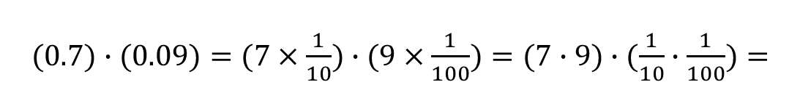
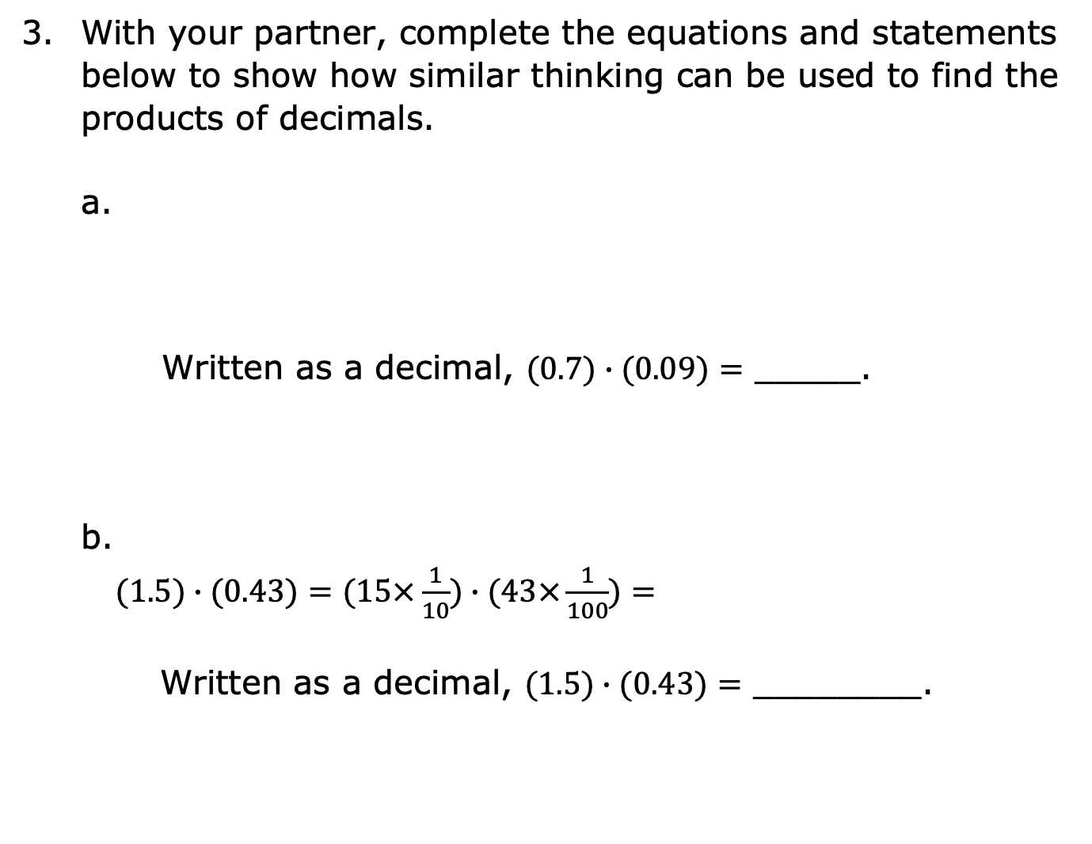
With your partner, complete the equations and statements below to show how similar thinking can be used to find the products of decimals.
Written as a decimal, $(0.7)∙(0.09)=$ _____.
$(1.5)∙(0.43)=(15×\frac{1}{10})∙(43×\frac{1}{100})=$
Written as a decimal, $(1.5)∙(0.43)=$ ________.
$(0.7)∙(0.09)=(7×\frac{1}{10})∙(9×\frac{1}{100})=(7∙9)∙(\frac{1}{10}∙\frac{1}{100})=$
volume 1, pg. 69

Slide 12

Guided Instruction
volume 1, pg. 69

Slide 13
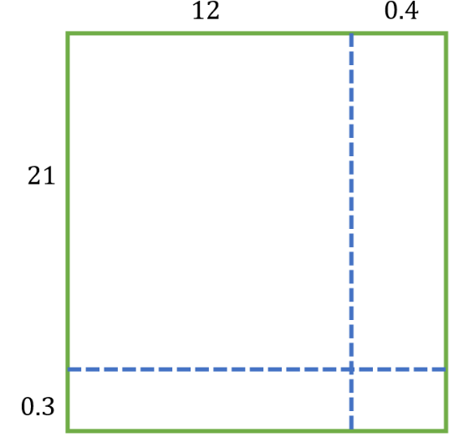
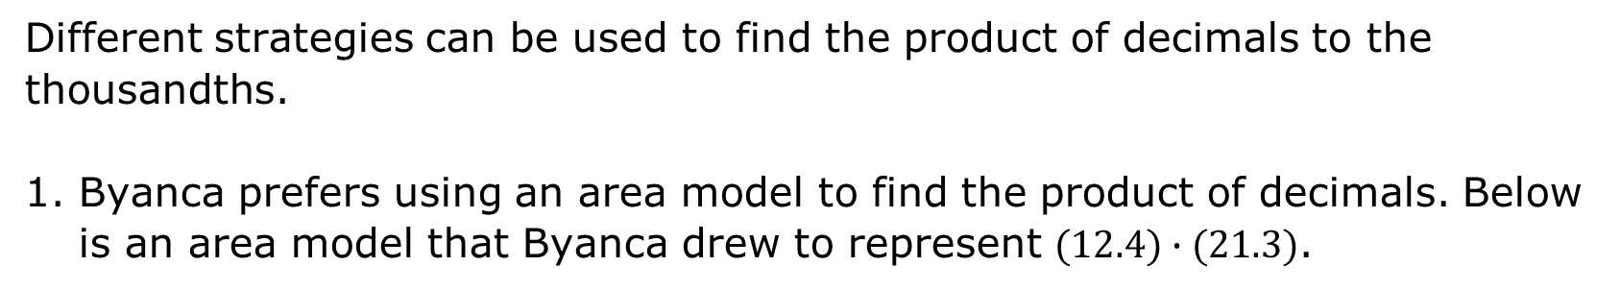
2.5.3 Guided Instruction: Multiplying Decimals to the Thousandths
Different strategies can be used to find the product of decimals to the thousandths.
Byanca prefers using an area model to find the product of decimals. Below is an area model that Byanca drew to represent $(12.4)∙(21.3)$.
volume 1, pg. 69

Slide 14
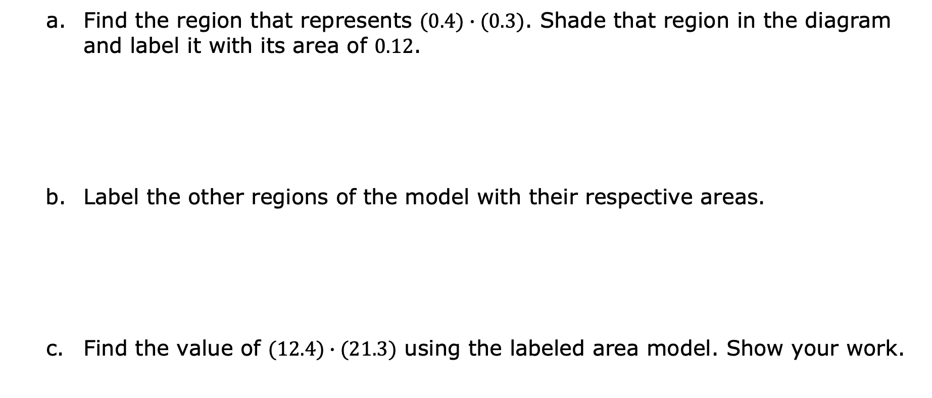
Find the region that represents $(0.4)∙(0.3)$. Shade that region in the diagram and label it with its area of $0.12$.
Label the other regions of the model with their respective areas.
Find the value of $(12.4)∙(21.3)$ using the labeled area model. Show your work.
volume 1, pg. 69

Slide 15
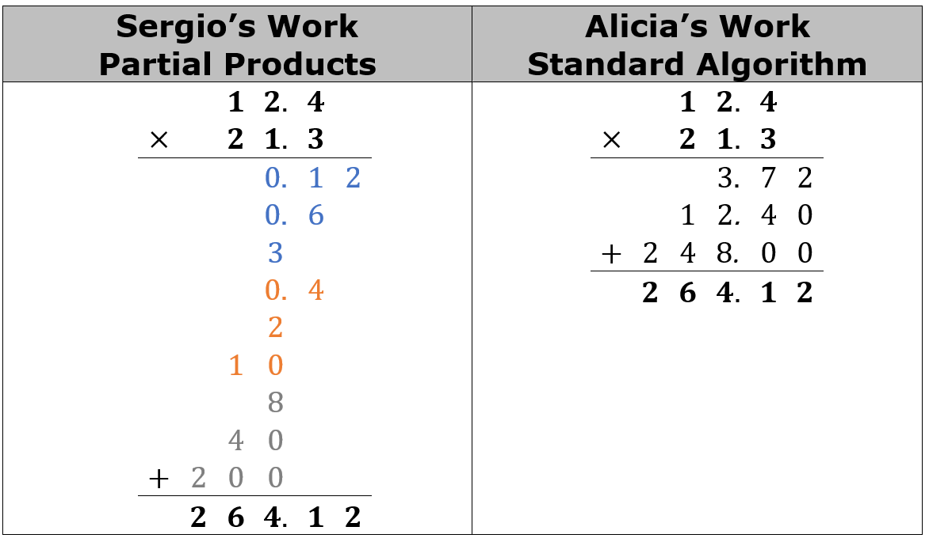
Sergio prefers to use partial products to find the value of $(12.4)∙(21.3)$, while Alicia prefers using the standard algorithm. Their work is shown.
volume 1, pg. 70

Slide 16
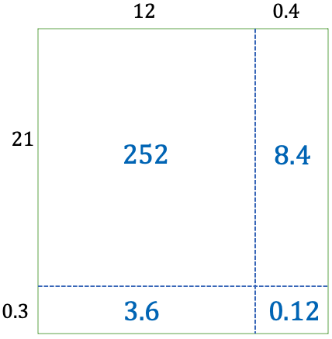
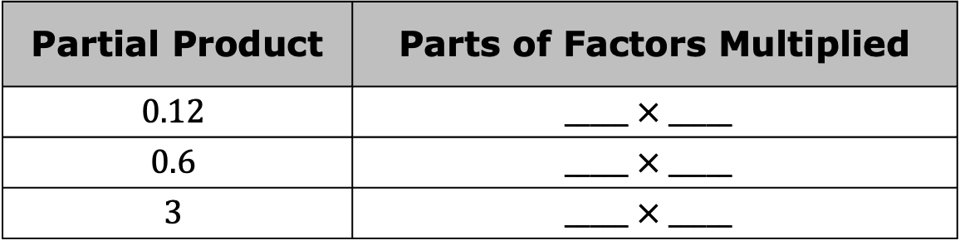
Discuss each method with your partner while answering the following questions.
In Sergio’s work, which parts of the factors were multiplied to get each partial product indicated in the table below?
To which parts of the
area model do these
partial products relate?
Partial Product | Parts of Factors Multiplied
$$0.12$$ | $$_____ × _____$$
$$0.6$$ | $$_____ × _____$$
$$3$$ | $$_____ × _____$$
volume 1, pg. 70

Slide 17
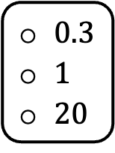
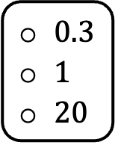
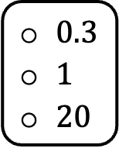
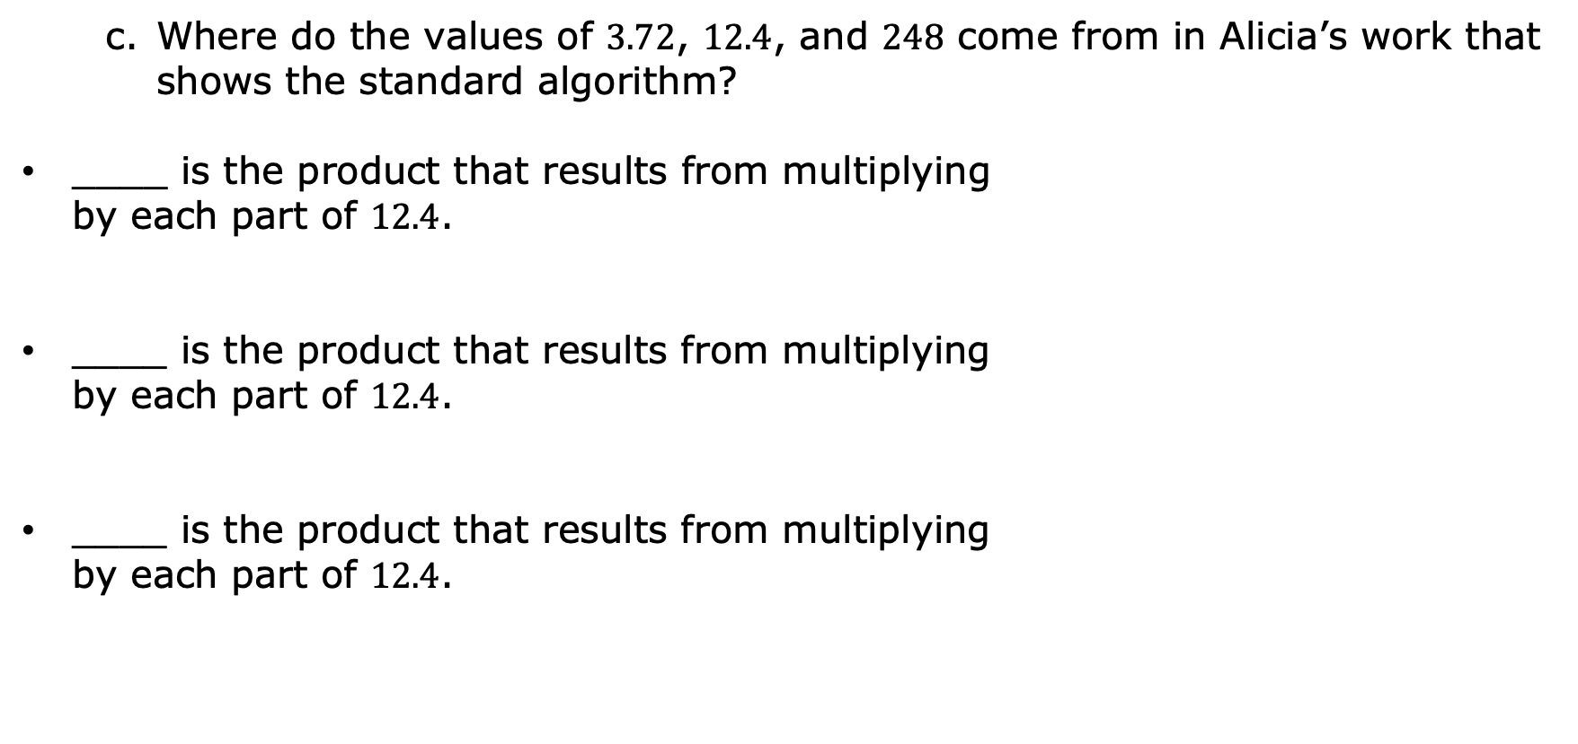
Where do the values of $3.72$, $12.4$, and $248$ come from in Alicia’s work that shows the standard algorithm?
____ is the product that results from multiplying
by each part of $12.4$.
____ is the product that results from multiplying
by each part of $12.4$.
____ is the product that results from multiplying
by each part of $12.4$.
$0.3$
$1$
$20$
$0.3$
$1$
$20$
$0.3$
$1$
$20$
volume 1, pg. 70

Slide 18
Draw lines to indicate connections between the partial products found in each of Sergio and Alicia’s methods.
In each method, why are the numbers between the horizontal lines aligned vertically?
volume 1, pg. 70

Slide 19

Guided Practice
volume 1, pg. 71

Slide 20

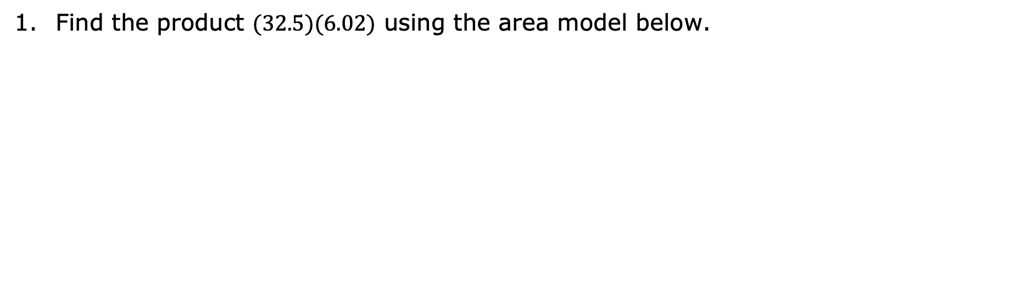
2.5.4 Guided Practice: Multiplying Decimals to the Thousandths
Find the product $(32.5)(6.02)$ using the area model below.
volume 1, pg. 71

Slide 21
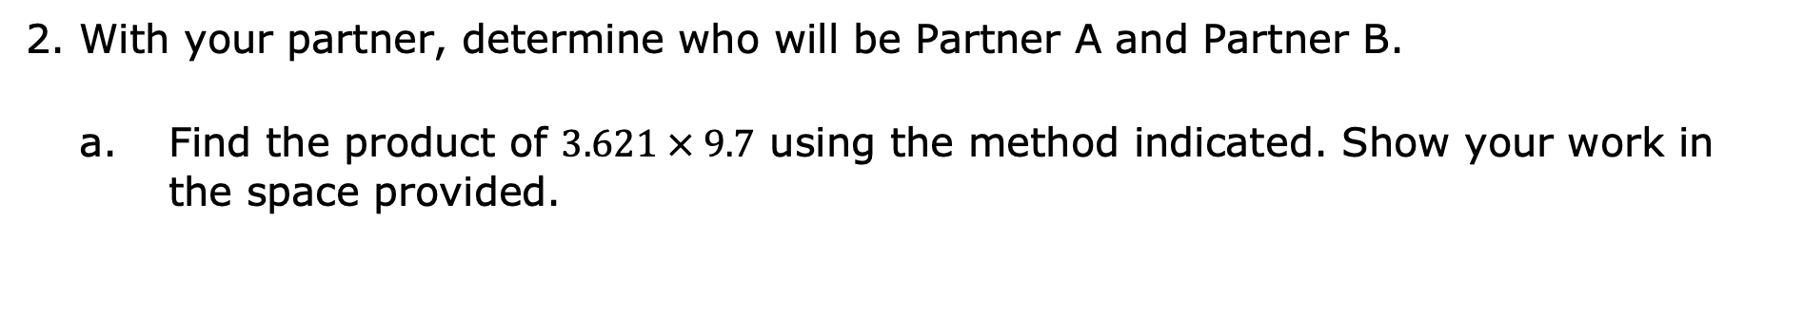
With your partner, determine who will be Partner A and Partner B.
Find the product of $3.621 × 9.7$ using the method indicated. Show your work in the space provided.
Partner A | Partner B
Partial Products | Standard Algorithm
volume 1, pg. 71

Slide 22
Compare your work with your partner to verify that you both found the same product. Discuss any errors and make corrections as needed. Once you have come to an agreement, write your partner’s work in your workbook in the space provided.
Discuss with your partner the strengths and weaknesses of using each method.
Which method do you prefer for multiplying decimals to the thousandths?
volume 1, pg. 71

Slide 23

Try It
volume 1, pg. 72

Slide 24


2.5.5 Try It: Multiplying Decimals to the Thousandths
Find each product using your preferred method. Show your work.
$\text{a}\text{.} 25.36 ∙ 14.8$
b. $19.008 × 3.2$
c. $(36.3)(0.74)$
volume 1, pg. 72

Slide 25

Your Turn
volume 1, pg. 72

Slide 26
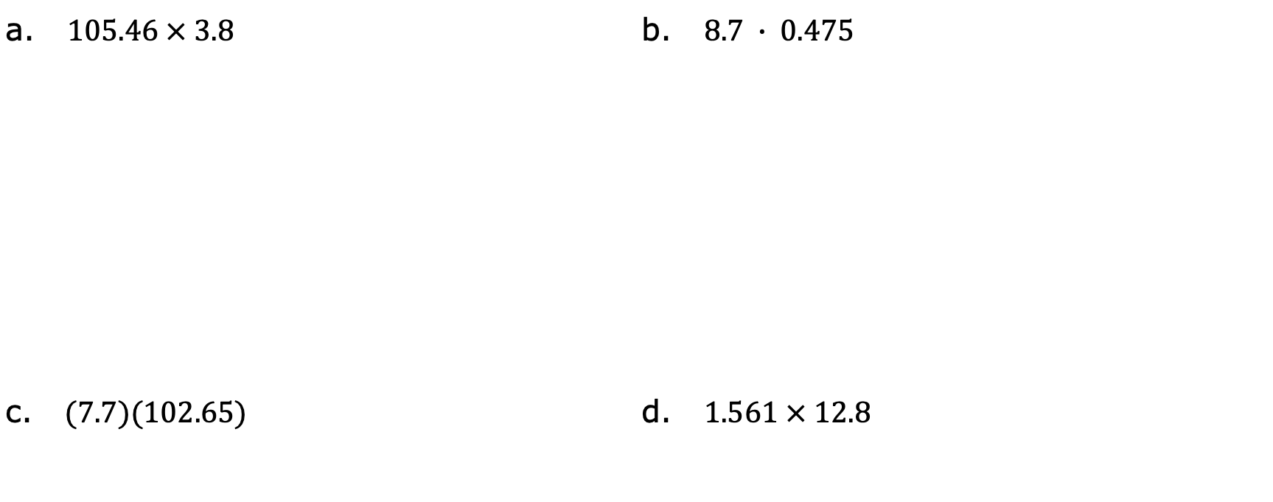
2.5.6 Your Turn!
Find each product.
a. $105.46 × 3.8$ | b. $8.7 ∙ 0.475$
c. $(7.7)(102.65)$ | d. $1.561 × 12.8$
volume 1, pg. 72

Slide 27

Wrap-Up
volume 1, pg. 73

Slide 28

2.5.7 Wrap-Up: Ticket Out the Door
Find each product.
a. $\left(6.36\right)\left(12.27\right)$
b. $8.12 ∙ 29.4$
volume 1, pg. 73

